Slide 1




GRADE 10 · ALGEBRA II · TOPIC 2
Lesson 2-6
The Quadratic
Formula
Journey of 6 stations, 60 minutes
Quadratic Functions and Equations
Mr Malek Thiab
FAITH, RIGHTEOUSNESS AND WISDOM
Notes:
Speaker notes: Welcome to Lesson 2-6: The Quadratic Formula.
Timing: 60 minutes (Diagnose 6, Targeted Instruction 18, Practice 12, Production 12, Mastery Gate 6, Smart Production 6). For a 40-minute class scale every station by two thirds.
The journey map on the next slide shows the six stations; in slideshow mode the Morph transition zooms the station circles into the breadcrumb at the top of every later slide.

Slide 2


Today's journey
Six stations. Each one zooms in as we arrive.
Targeted Instruction
18 min
Production
12 min
Smart Production
6 min
2
4
6
1
3
5
Diagnose
6 min
Practice
12 min
Mastery Gate
6 min
FAITH, RIGHTEOUSNESS AND WISDOM
Notes:
Speaker notes: This is the whole map. Walk it left to right: Diagnose (what we already know), Targeted Instruction (The quadratic formula; The discriminant; Nonreal solutions; The discriminant with an unknown), Practice (Practice, Apply, Investigate), Production (Jeddah Season ticket price), Mastery Gate (three questions to pass), Smart Production (create, then Time to Check).
In slideshow mode the Morph transition animates these circles shrinking into the breadcrumb on later slides; without Morph the slides fade.
Ask the class which station they think will be hardest.

Slide 3
What we are learning
OBJECTIVES
VOCABULARY
Analyze the discriminant to identify the number and type of solutions for a quadratic equation.
Solve quadratic equations using the quadratic formula, including those with nonreal solutions.
Discriminant
quadratic formula
STANDARDS
HSN.CN.C.7 Solve quadratic equations with real coefficients that have complex solutions.
HSA.REI.B.4.A Use the method of completing the square to transform any quadratic equation in x into an equation of the form (x - p)² = q that has the same solutions. Derive the quadratic formula from this form.
HSA.REI.B.4.B Solve quadratic equations by inspection (e.g., for x² = 49), taking square roots, completing the square, the quadratic formula and factoring, as appropriate to the initial form of the equation. Recognize when the quadratic formula gives complex solutions and write them as a ± bi for real numbers a and b.
HSN.CN.C.7 · HSA.REI.B.4.A · HSA.REI.B.4.B
FAITH, RIGHTEOUSNESS AND WISDOM
Mr Malek Thiab · 3
Notes:
Speaker notes: Read the objectives aloud one at a time and have students say which one they feel least sure about.
Vocabulary used today: Discriminant, quadratic formula.
Standards are listed on this slide.
The essential question and mathematical practices are not shown because they are not in the project documents; add them from the curriculum map if you want them displayed.

Slide 4
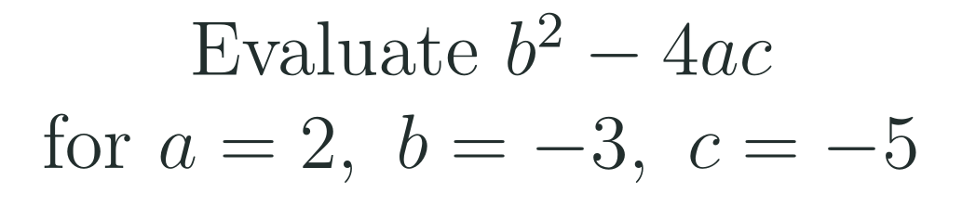
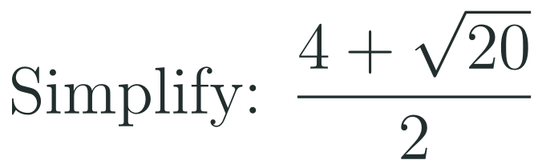
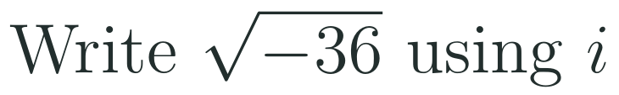
1
2
3
4
5
6
STATION 1 · DIAGNOSE · 6 MIN
Start here: three quick checks
1
2
3
Done when
All three answers are written without a calculator, and you can say what goes wrong if the minus sign in Question 1 is lost.
HSN.CN.C.7 · HSA.REI.B.4.A · HSA.REI.B.4.B
FAITH, RIGHTEOUSNESS AND WISDOM
Mr Malek Thiab · 4
Notes:
Speaker notes (Diagnose, 6 min, no calculator):
Answers. Q1: b² = (−3)² = 9 and −4ac = −4(2)(−5) = +40, so b² − 4ac = 9 + 40 = 49. Q2: √20 = 2√5, so the top is 4 + 2√5; dividing EVERY term by 2 gives 2 + √5. Q3: √(−36) = √36 × √(−1) = 6i. Verbal misconceptions: Q1 students write (−3)² as −9 and get −9 + 40 = 31, or lose the sign of −4ac and get 9 − 40 = −31; Q2 students divide only the 4 and write 2 + √20, or write √20 ÷ 2 = √10; Q3 students write −6 or say 'impossible' (it is not a real number, but it is 6i). Adaptive routing: if >30% miss Q1, rehearse substituting negative numbers inside brackets for 2 minutes, then go to slide 5 / block 1; if >30% miss Q2, work two more radical fractions such as (6 + √12)/2 before slide 5 / block 1 Example C; if >30% miss Q3, recall Lesson 2-4 (√(−n) = √n · i) and go to slide 7 / block 3. If all three are secure, move quickly through slide 5 and start the Investigate route early.

Slide 5







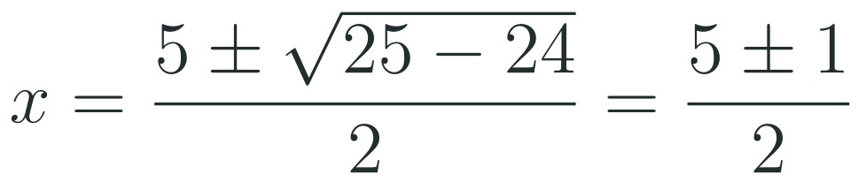
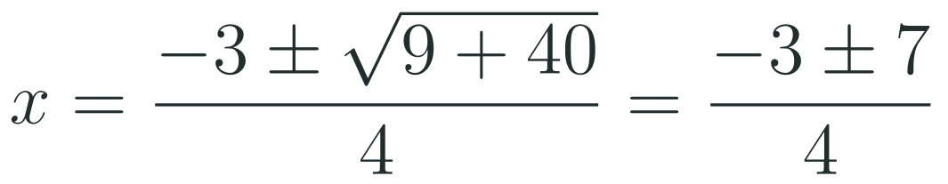
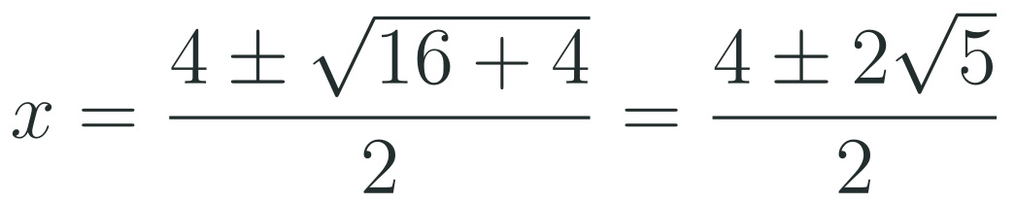

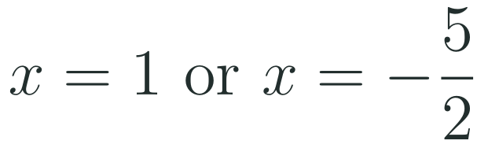
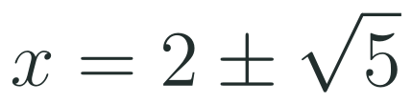
1
2
3
4
5
6
STATION 2 · TARGETED INSTRUCTION · 18 MIN
The quadratic formula
EXAMPLE A
EXAMPLE B
EXAMPLE C
HSN.CN.C.7 · HSA.REI.B.4.A · HSA.REI.B.4.B
FAITH, RIGHTEOUSNESS AND WISDOM
Mr Malek Thiab · 5
Notes:
Speaker notes (Targeted Instruction, block 1 of 4):
Worked solutions. The formula comes from completing the square on ax² + bx + c = 0 (Lesson 2-5): divide by a, add (b/2a)² to both sides, take square roots. Always write a, b and c WITH their signs, then substitute. Example A: a = 1, b = −5, c = 6. x = (5 ± √(25 − 24))/2 = (5 ± 1)/2, so x = 3 or x = 2. Check x = 3: 9 − 15 + 6 = 0. Example B: a = 2, b = 3, c = −5. b² − 4ac = 9 + 40 = 49; x = (−3 ± 7)/4, so x = 4/4 = 1 or x = −10/4 = −5/2. Check x = 1: 2 + 3 − 5 = 0. Example C: a = 1, b = −4, c = −1. b² − 4ac = 16 + 4 = 20; √20 = 2√5; x = (4 ± 2√5)/2 = 2 ± √5 (about 4.24 and −0.24). Verbal misconceptions: (1) using b instead of −b: with b = −5 the numerator starts with +5, not −5; (2) writing (−4)² as −16; (3) dividing by 2 instead of 2a in Example B (the denominator is 4); (4) dividing only one term by 2 in Example C: (4 ± 2√5)/2 is not 4 ± √5; (5) treating the whole fraction as '−b ± √… over 2 times a' by mistake with the a outside. Adaptive routing: if >30% give x = 2.5 or x = −1.5 in Example B (dividing by 2 not 4), redo with the denominator boxed as 2a = 4; if >30% miss Q2 of the Mastery Gate, come back to this slide (slide 5 / block 1).

Slide 6

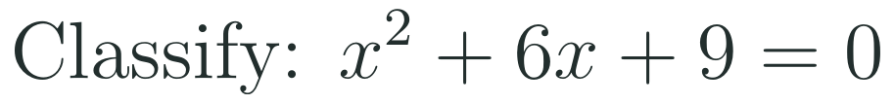
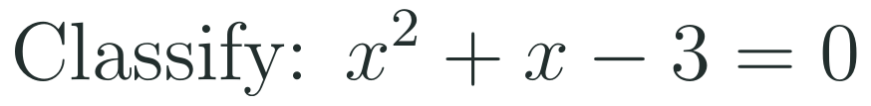
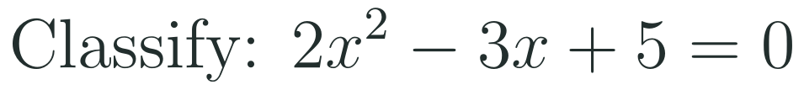





1
2
3
4
5
6
STATION 2 · TARGETED INSTRUCTION · 18 MIN
The discriminant
EXAMPLE A
EXAMPLE B
EXAMPLE C
HSN.CN.C.7 · HSA.REI.B.4.A · HSA.REI.B.4.B
FAITH, RIGHTEOUSNESS AND WISDOM
Mr Malek Thiab · 6
Notes:
Speaker notes (Targeted Instruction, block 2 of 4):
Worked solutions. The discriminant is the part under the square root, Δ = b² − 4ac, and its sign decides everything before any solving. Example A: a = 1, b = 6, c = 9, Δ = 36 − 36 = 0, so there is exactly one real solution (a repeated solution) x = −6/2 = −3; the equation is (x + 3)² = 0. Example B: a = 1, b = 1, c = −3, Δ = 1 + 12 = 13; positive, so two real solutions; 13 is not a perfect square, so the solutions (−1 ± √13)/2 are irrational. Example C: a = 2, b = −3, c = 5, Δ = 9 − 40 = −31 < 0, so two nonreal (complex) solutions that are conjugates of each other. Type rule: Δ > 0 and a perfect square (such as 1, 4, 9, 49) gives two real RATIONAL solutions, which also means the quadratic factors over the integers; Δ > 0 and not a perfect square gives two real IRRATIONAL solutions. Verbal misconceptions: (1) 'Δ = 0 means no solution' (it means exactly one real solution); (2) treating a negative Δ as 'no solution' instead of two nonreal solutions; (3) computing b² − 4ac with a sign slip, for example −3² = −9 in Example C; (4) saying Δ is the solution. Adaptive routing: if >30% give Δ = 9 + 40 = 49 in Example C, return to the Diagnose slide Q1 (slide 4) and redo negative substitution; if >30% miss Q1 of the Mastery Gate, come back to this slide (slide 6 / block 2).

Slide 7




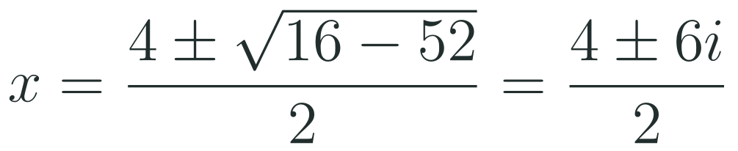
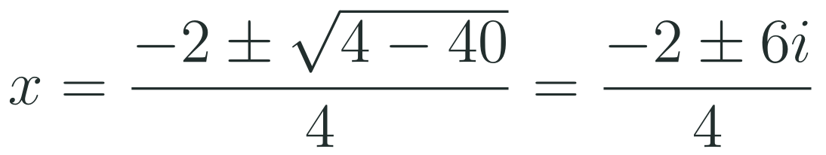
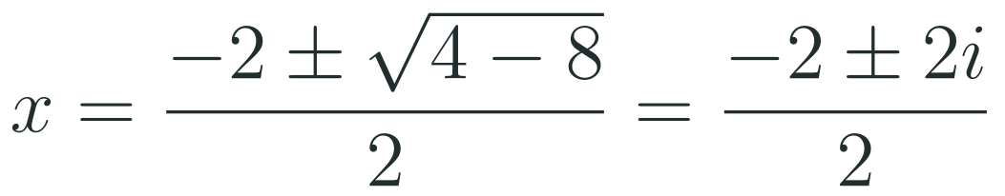

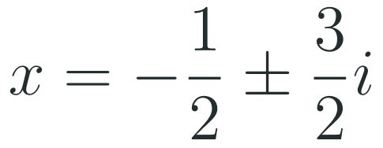

1
2
3
4
5
6
STATION 2 · TARGETED INSTRUCTION · 18 MIN
Nonreal solutions
EXAMPLE A
EXAMPLE B
EXAMPLE C
HSN.CN.C.7 · HSA.REI.B.4.A · HSA.REI.B.4.B
FAITH, RIGHTEOUSNESS AND WISDOM
Mr Malek Thiab · 7
Notes:
Speaker notes (Targeted Instruction, block 3 of 4):
Worked solutions. When Δ < 0 the formula still works: √Δ = √(−n) = √n · i (Lesson 2-4). Write the answer as a ± bi and divide BOTH the real part and the imaginary part by 2a. Example A: Δ = 16 − 52 = −36; √(−36) = 6i; x = (4 ± 6i)/2 = 2 ± 3i. Check with the sum and product: (2 + 3i) + (2 − 3i) = 4 = −b/a; (2 + 3i)(2 − 3i) = 4 + 9 = 13 = c/a. Example B: a = 2, b = 2, c = 5; Δ = 4 − 40 = −36; x = (−2 ± 6i)/4 = −1/2 ± (3/2)i. Example C: Δ = 4 − 8 = −4; √(−4) = 2i; x = (−2 ± 2i)/2 = −1 ± i. The graph of y = x² − 4x + 13 never meets the x-axis, which is why the solutions are not real. Verbal misconceptions: (1) writing x = 4 ± 6i/2 (dividing only the imaginary part) or 2 ± 6i; (2) writing √(−36) = −6 or 6 without the i; (3) giving only one of the pair (the ± gives two solutions); (4) in Example B dividing by 2 instead of 4; (5) saying 'no solution' for Δ < 0. Adaptive routing: if >30% give 4 ± 3i in Example A, circle the whole numerator and divide each term; if >30% miss Q3 of the Mastery Gate, come back to this slide (slide 7 / block 3).

Slide 8
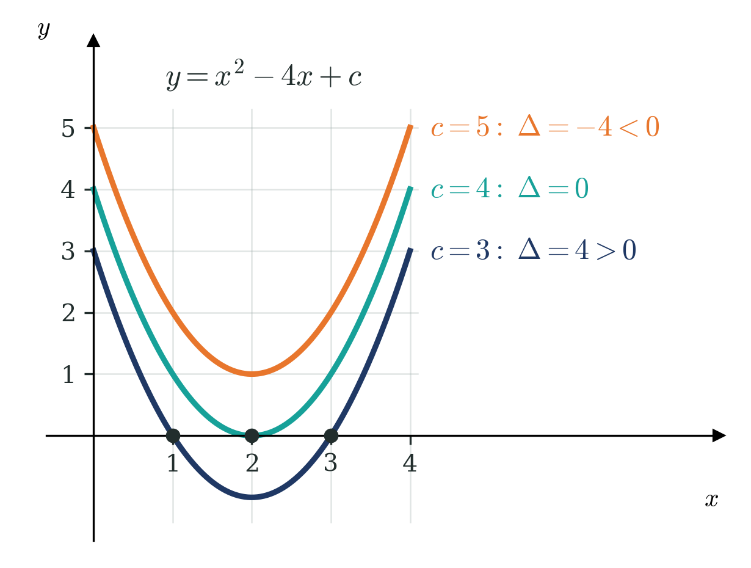




1
2
3
4
5
6
STATION 2 · TARGETED INSTRUCTION · 18 MIN
The discriminant with an unknown
EXAMPLE A
EXAMPLE B
HSN.CN.C.7 · HSA.REI.B.4.A · HSA.REI.B.4.B
FAITH, RIGHTEOUSNESS AND WISDOM
Mr Malek Thiab · 8
Notes:
Speaker notes (Targeted Instruction, block 4 of 4):
Worked solutions. When a coefficient is unknown, write the discriminant in terms of k and set it equal to 0 (one real solution), greater than 0 (two) or less than 0 (none). Example A: a = 1, b = −4, c = k, so Δ = 16 − 4k = 0 and k = 4: the graph y = x² − 4x + 4 just touches the x-axis at x = 2 (the teal curve). The graph shows the family y = x² − 4x + c: c = 3 gives Δ = 4 and two x-intercepts (1 and 3), c = 4 gives Δ = 0 and one, c = 5 gives Δ = −4 and none. Example B: a = 1, b = k, c = 16, so Δ = k² − 4(16) = k² − 64 = 0, k² = 64, k = 8 or k = −8 (two values, because k is squared). For no real solutions in Example A: 16 − 4k < 0, so k > 4. Verbal misconceptions: (1) in Example B giving only k = 8; (2) writing b² as k and forgetting the square; (3) reversing the inequality when dividing by −4; (4) confusing 'one solution' with 'one value of k'. Adaptive routing: if >30% give k = 8 only in Example B, ask 'what else squares to 64?' and show the graph for k = −8; if >30% miss the SAT item on the Exam slide (slide 13), return to Example A (slide 8 / block 4).

Slide 9


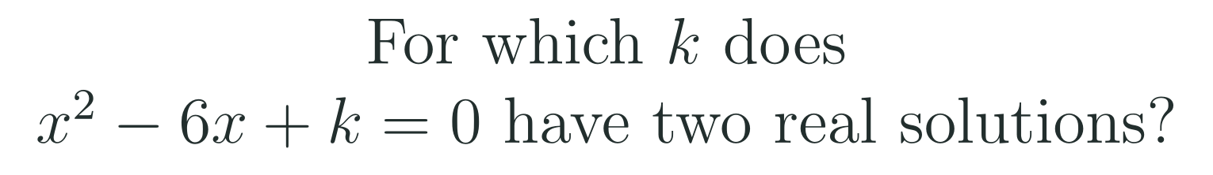
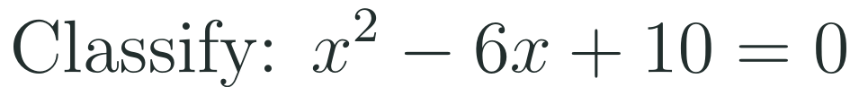

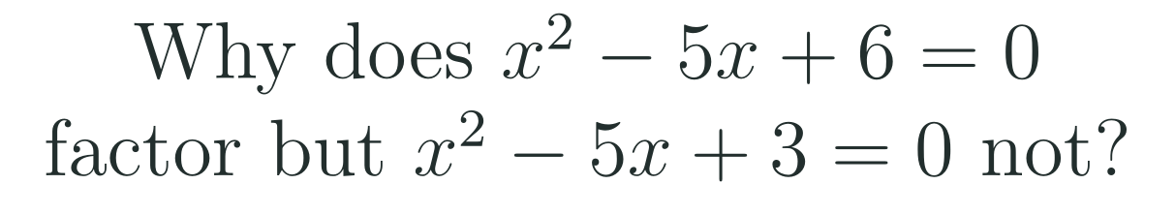
1
2
3
4
5
6
STATION 3 · PRACTICE · 12 MIN
Give it a go: Practice, Apply, Investigate
PRACTICE
APPLY
INVESTIGATE
Secure the method
Use it in context
Find out why
Done when: a, b and c are written with their signs, the discriminant is found first, and each real solution is checked by substitution.
Done when: the answers are exact, the radical is simplified, every term of the numerator is divided by the denominator, and nonreal solutions are written in the form a ± bi.
Done when: your argument names the discriminant, says what its value tells you about the solutions, and reaches an inequality for k.
HSN.CN.C.7 · HSA.REI.B.4.A · HSA.REI.B.4.B
FAITH, RIGHTEOUSNESS AND WISDOM
Mr Malek Thiab · 9
Notes:
Speaker notes (Practice, 12 min; tierless differentiation: students choose the starting column and may move across):
Answers. Practice 1: a = 2, b = −5, c = −3; Δ = 25 + 24 = 49; x = (5 ± 7)/4 = 3 or −1/2. Check x = 3: 18 − 15 − 3 = 0. Practice 2: Δ = 36 − 40 = −4 < 0, so two nonreal solutions (x = 3 ± i). Apply 1: Δ = 36 + 24 = 60; √60 = 2√15; x = (6 ± 2√15)/6 = 1 ± √15/3 (about 2.29 and −0.29). Apply 2: Δ = 36 − 100 = −64; √(−64) = 8i; x = (−6 ± 8i)/2 = −3 ± 4i. Investigate 1: Δ = 36 − 4k > 0, so k < 9 (k = 9 gives one solution, k > 9 none). Investigate 2: for x² − 5x + 6, Δ = 25 − 24 = 1, a perfect square, so the solutions (5 ± 1)/2 = 3 and 2 are rational and the quadratic factors as (x − 2)(x − 3); for x² − 5x + 3, Δ = 25 − 12 = 13 is not a perfect square, so the solutions (5 ± √13)/2 are irrational and there are no integer factors. Verbal misconceptions: students lose the sign of b, divide only part of the numerator by 2a, stop at 'Δ < 0, no solution', or reverse the inequality sign in Investigate 1. Adaptive routing: if most students finish Practice quickly, move them to Apply; students who choose Investigate may need the hint 'Δ = 36 − 4k must be positive'; if >30% miss Apply 2, return to slide 7 / block 3.

Slide 10
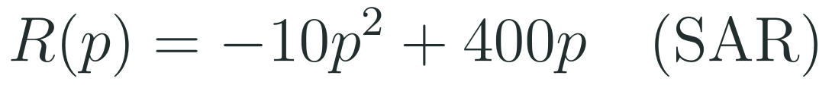
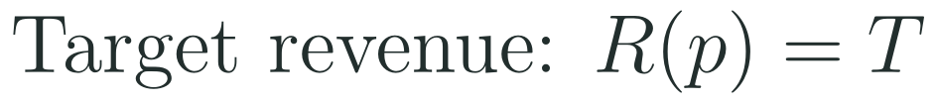
1
2
3
4
5
6
STATION 4 · PRODUCTION · 12 MIN
Production: Jeddah Season ticket price
THE MODEL
DONE WHEN
Organisers of a Jeddah Season concert, part of the Vision 2030 entertainment programme, model the ticket revenue in riyals as a quadratic function of the ticket price in riyals, given below. These are model values, not real figures.
Each task rewrites the revenue equation as a quadratic equal to zero and writes a, b and c with their signs.
The discriminant is calculated and its sign gives the number of prices.
Task 1 gives two prices, exact and decimal, and one is checked by substitution.
Task 3 ends with a sentence in context and says the numbers are model values.
Find the ticket prices that give a revenue of 2 000 SAR, exactly and to the nearest 0.01 SAR.
Show that a revenue of 4 000 SAR is possible at exactly one price, and state it.
A sponsor asks for 5 000 SAR. Use the discriminant to explain why no price works.
Hint for solving: divide every term by 10 before you use the formula.
HSN.CN.C.7 · HSA.REI.B.4.A · HSA.REI.B.4.B
FAITH, RIGHTEOUSNESS AND WISDOM
Mr Malek Thiab · 10
Notes:
Speaker notes (Production, 12 min):
Model values only. Task 1: −10p² + 400p = 2 000 gives 10p² − 400p + 2 000 = 0, or p² − 40p + 200 = 0. Δ = 1 600 − 800 = 800 > 0 (with a = 10: Δ = 160 000 − 80 000 = 80 000). p = (40 ± √800)/2 = (40 ± 20√2)/2 = 20 ± 10√2, so p ≈ 34.14 SAR or p ≈ 5.86 SAR. Check p = 20 + 10√2: R = 2 000. Task 2: R = 4 000 gives p² − 40p + 400 = 0; Δ = 1 600 − 1 600 = 0, so exactly one price, p = 20 SAR; R(20) = −4 000 + 8 000 = 4 000, the greatest revenue (the vertex). Task 3: R = 5 000 gives p² − 40p + 500 = 0; Δ = 1 600 − 2 000 = −400 < 0, so there is no real price: the greatest possible revenue is 4 000 SAR, so 5 000 SAR cannot be reached. Verbal misconceptions: students forget to move T to the left so the equation equals zero; they use the sign of b wrongly (b = −400 after rearranging); they say Δ < 0 means 'a mistake' rather than 'impossible target'; they keep both prices in Task 1 without checking they are positive (both are). Adaptive routing: if most groups cannot rearrange in Task 1, return to slide 5 / block 1 Example A; groups that finish early can find the two prices for a revenue of 3 000 SAR (10 and 30).

Slide 11
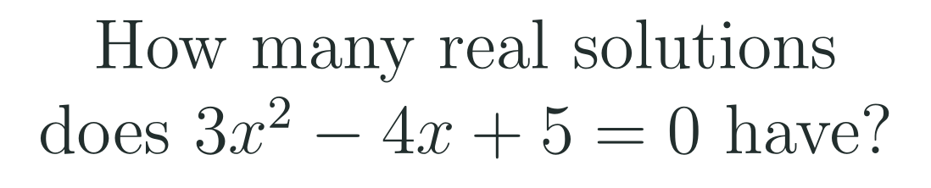


1
2
3
4
5
6
STATION 5 · MASTERY GATE · 6 MIN
Mastery Gate: three questions to pass
1
2
3
Pass mark
3 of 3 correct unlocks Station 6. Fewer than that: return to the slide for the question you missed, redo it, then re-take the gate.
HSN.CN.C.7 · HSA.REI.B.4.A · HSA.REI.B.4.B
FAITH, RIGHTEOUSNESS AND WISDOM
Mr Malek Thiab · 11
Notes:
Speaker notes (Mastery Gate, 6 min, no calculator):
Answers. Q1: Δ = 16 − 60 = −44 < 0, so there are no real solutions (two nonreal). Q2: Δ = 36 − 16 = 20; x = (−6 ± 2√5)/2 = −3 ± √5. Q3: Δ = 4 − 68 = −64; √(−64) = 8i; x = (−2 ± 8i)/2 = −1 ± 4i. Verbal misconceptions: Q1 students write Δ = −16 − 60 or 16 + 60 = 76 and answer 'two'; Q2 students write x = (−6 ± √20)/2 = −3 ± √20 (dividing only one term) or use b = −6; Q3 students write x = −2 ± 8i or −1 ± 8i. Adaptive routing: students who miss Q1 return to slide 6 / block 2; Q2, slide 5 / block 1; Q3, slide 7 / block 3. Students who score 3 out of 3 move to Smart Production.

Slide 12

1
2
3
4
5
6
STATION 6 · SMART PRODUCTION · 6 MIN
Smart Production: make one, then check it
CREATE
TIME TO CHECK
Write three quadratic equations of your own: one with a positive discriminant, one with a zero discriminant and one with a negative discriminant.
Swap with a partner. Find the discriminant of each equation and solve it with the quadratic formula.
Check one real solution by substitution, and say how the discriminant showed the type of solutions.
Exit ticket: write your answer on a sticky note and place it on the door.
Done when: all three discriminants are correct, the solutions match their signs, and the check is written.
Next lesson: 2-7 Solving Linear-Quadratic Systems.
HSN.CN.C.7 · HSA.REI.B.4.A · HSA.REI.B.4.B
FAITH, RIGHTEOUSNESS AND WISDOM
Mr Malek Thiab · 12
Notes:
Speaker notes (Smart Production, 6 min):
Exit ticket solution. a = 1, b = −6, c = 13; Δ = 36 − 52 = −16; √(−16) = 4i; x = (6 ± 4i)/2 = 3 ± 2i. Create task examples: x² + 2x − 3 = 0 has Δ = 16 and x = 1 or −3; x² + 2x + 1 = 0 has Δ = 0 and x = −1; x² + 2x + 5 = 0 has Δ = −16 and x = −1 ± 2i. Verbal misconceptions: students think Δ < 0 means 'no solution', divide only the real part by 2, or give only one of the conjugate pair. Adaptive routing: collect the sticky notes and sort into correct, sign error in b, and only part of the numerator divided; start the next lesson with the most common error.

Slide 13
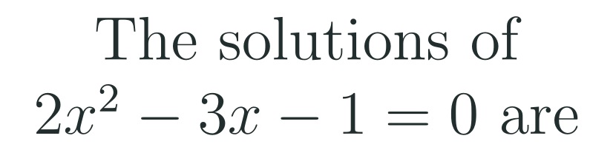
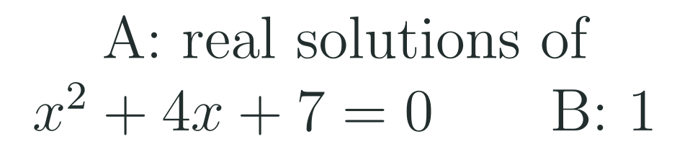
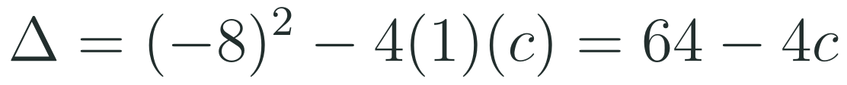



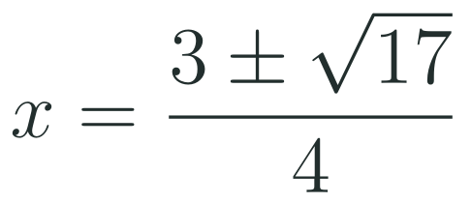


Exam connections
SAT
GAT
SAAT
STEPS
STEPS
STEPS
1
1
1
2
2
2
3
3
HSN.CN.C.7 · HSA.REI.B.4.A · HSA.REI.B.4.B
FAITH, RIGHTEOUSNESS AND WISDOM
Mr Malek Thiab · 13
Notes:
Speaker notes: each exam item is worked in numbered steps.
SAT (Advanced Math, grid-in): one real solution means Δ = 0; Δ = 64 − 4c = 0 gives c = 16 (traps: c = 64, from forgetting the 4a; c = 4, from using half of b as c; c = −16, from a sign slip). GAT / Qudurat (quantitative comparison): Δ = 16 − 28 = −12 < 0, so A has 0 real solutions, and 0 < 1, so B is greater (trap: assuming every quadratic has two solutions and choosing A or 'equal'). SAAT / Tahsili: Δ = (−3)² − 4(2)(−1) = 9 + 8 = 17; x = (3 ± √17)/4 (traps: (−3 ± √17)/4 from the wrong sign of b; (3 ± √17)/2 from dividing by 2 instead of 2a = 4; Δ = 9 − 8 = 1 from losing the sign of c). Verbal reminders: write a, b, c with signs, and always find Δ first.

Slide 14
Journey complete
Targeted Instruction
Production
Smart Production
✓
✓
✓
✓
✓
✓
Diagnose
Practice
Mastery Gate
The discriminant b² − 4ac tells you how many solutions and of what type, and the quadratic formula then solves any quadratic, giving a ± bi when the discriminant is negative.
FAITH, RIGHTEOUSNESS AND WISDOM
Notes:
Speaker notes: Every station is checked off. Recap in one sentence: The discriminant b² − 4ac tells you how many solutions and of what type, and the quadratic formula then solves any quadratic, giving a ± bi when the discriminant is negative. Collect the Time to Check responses. Next lesson: 2-7 Solving Linear-Quadratic Systems.

